Slide 1

Using Stocks in Different Timezones to Predict Each Other’s Movement
Mitchell Gil 2019

Slide 2
The Problem
Using Stocks in Different Timezones to Predict Each Other’s Movement

Slide 3
Stakeholders
Investors wishing for a new way to make more accurate predictions on their stocks.
Investors wishing to see if performance of cetrain stocks are a reflection of the general trading day or a reflection of the stock’s performance.

Slide 4
Data Information
The four incides have varying ranges of numerical values.
All look to have similar trends
Must convert to percentage change

Slide 5
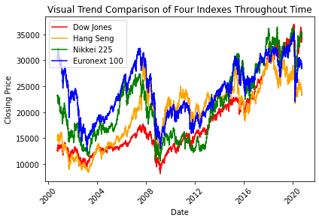
Data Information

Slide 6
Data Exploration
No missing values
Different exchanges close at different dates
90% of trading days had activity in all four indices

Slide 7
Data Models Chosen
Problem is a regression style model
Used common regression scikitlearn models
Knearest Regressor
XGBRegressor
RandomForest Regressor
Linear Regression

Slide 8
Initial Modeling
Test train Split was done 80-20 using unconventional TimeSeriesSplit().
Allows conservation of ordered rows
Model isolated Dow Jonesand tested it against the other three indices

Slide 9
Initial Modeling
Initial models using negative mean squared regressor metric performance LR: -0.797767 (0.628795)
KNN: -1.669319 (1.253311)
XGB: -1.460775 (1.113711)
RFR: -1.189993 (0.886198)

Slide 10
Model tuning
Linear Regression not tunable
Other three tuned n_estimators
KNR tuned n_neighbors
XGBoost tuned base_score and learning rate

Slide 11
Model tuning
Tuning did not alter mean squared error metrics much
KNN: -1.2367414767293954
XGB: -1.1476706434330874
RFR: -1.14195235219997

Slide 12
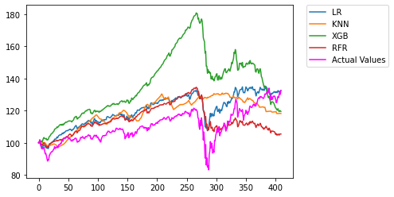
Findings

Slide 13
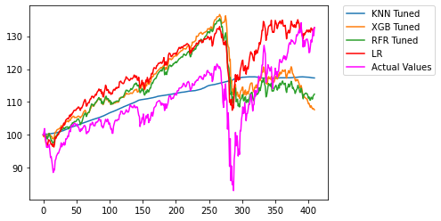
Findings

Slide 14
Findings
Linear Regression and Random Forest Regressor provided best metrics.
Linear Regression is favored due to lower computational time.
KNR provided nothing useful

Slide 15
Findings
XBGBoost required time-consuming tuning to provide a usable model.

Slide 16
Conclusion
Linear Regression shows that índices can predict to within a 1.2 percentage point of each other’s general momentum

